Slide 1
Lecture 3 (online)
Presented by:
Naseem us Sehar

Slide 2
Test Case
Test Case is a simple pair of
<input, expected outcome>
State-less systems: A compiler is a stateless system
Test cases are very simple
Outcome depends solely on the current input
State-oriented: ATM is a state oriented system
Test cases are not that simple. A test case may consist of a sequences of <input, expected outcome>
The outcome depends both on the current state of the system and the current input
ATM example:
< check balance, $500.00 >,
< withdraw, “amount?” >,
< $200.00, “$200.00” >,
< check balance, $300.00 >

Slide 3
Expected Outcome
An outcome of program execution may include
Value produced by the program
State Change
A sequence of values which must be interpreted together for the outcome to be valid
What if expected outcome cannot be predicted?
Execute the program with the selected input.
Observe the actual outcome of program execution.
Verify that the actual outcome is the expected outcome.
Use the verified actual outcome as the expected outcome in subsequent runs of the test case.

Slide 4
Expected Outcome
A test oracle is a source of information about whether the output of a program (or function or method) is correct or not.
The oracle might be
a program (separate from the system under test) which takes the same input and produces the same output
documentation that gives specific correct outputs for specific given inputs
a documented algorithm that a human could use to calculate correct outputs for given inputs
a human domain expert who can somehow look at the output and tell whether it is correct
or any other way of saying that output is correct.

Slide 5
The Concept of Complete Testing
Complete or exhaustive testing means
“There are no undisclosed faults at the end of test phase”
Complete testing is near impossible for most of the system
The domain of possible inputs of a program is too large
Valid inputs
Invalid inputs
The design issues may be too complex to completely test
It may not be possible to create all possible execution environments of the system

Slide 6
The Central Issue in Testing
Divide the input domain D into D1 and D2
Select a subset D1 of D to test program P
It is possible that D1 exercise only a part P1 of P

Slide 7
Testing Activities
Identify the objective to be tested
Select inputs
Compute the expected outcome
Set up the execution environment of the program
Execute the program
Analyze the test results

Slide 8
Testing Level
Unit testing
Individual program units, such as procedure, methods in isolation
Integration testing
Modules are assembled to construct larger subsystem and tested
System testing
Includes wide spectrum of testing such as functionality, and load
System
testing comprises a number of distinct activities: creating a test plan, designing
a test suite, preparing test environments, executing the tests by following a clear
strategy, and monitoring the process of test execution
Acceptance testing
Customer’s expectations from the system
Two types of acceptance testing
UAT
BAT
UAT: System satisfies the contractual acceptance criteria
BAT: System will eventually pass the user acceptance test

Slide 9
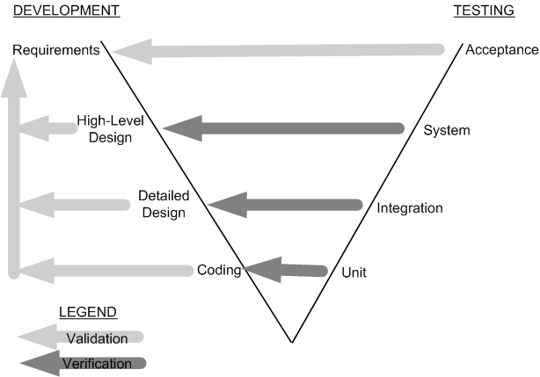
Testing levels (classical V model)

Slide 10
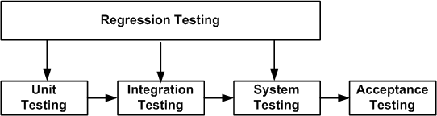
Regression Testing
New test cases are not designed
Test are selected, prioritized and executed
To ensure that nothing is broken in the new version of the software

Slide 11
Source of Information for Test Selection
Requirement and Functional Specifications
Source Code
Input and output Domain
Operational Profile
Fault Model (initialization faults, logic faults, and interface faults)
Error Guessing
Fault Seeding
Mutation Analysis

Slide 12
White-box Testing
White-box testing a.k.a. structural testing
Examines source code with focus on:
Control flow
Data flow
Control flow refers to flow of control from one instruction to another
Data flow refers to propagation of values from one variable or constant to another variable
It is applied to individual units of a program
Software developers perform structural testing on the individual program units they write

Slide 13
Black-box Testing
Black-box testing a.k.a. functional testing
Examines the program that is accessible from outside
Applies the input to a program and observe the externally visible outcome
It is applied to both an entire program as well as to individual program units
It is performed at the external interface level of a system
It is conducted by a separate software quality assurance group

Slide 14
BLACK BOX TESTING

Slide 15
EQUIVALENCE CLASS PARTITIONING
An input domain may be too large for all its elements to be used as test input
However, the input domain can be partitioned into a finite number of subdomains for selecting test inputs.
Each subdomain is known as an equivalence class (EC), and it serves as a source of at least one test input
The objective of equivalence partitioning is to divide the input domain of the system under test into classes, or groups, of inputs. All the inputs in the same class have a similar effect on the system under test

